Slide 1
Middle Eastern Tile Designs
5th Grade December Art Project
West Mercer Elementary Art Enrichment Program
Notes:
Presentation modified and prepared by Alice Finch 2013

Slide 2
How this PowerPoint Works
Some of the slides in this presentation are hidden. (The slide number has a box and slash through it.) A hidden slide will not be shown in ‘slide show’ mode. It is visible and can be edited etc. in ‘normal’ mode. You can change modes on the view tab or with the icons in the lower right corner.
If you want to print this presentation, please select ‘2 slides per page’ to save on toner and paper.

Slide 3
Lesson Overview 1
Lesson: symmetry, geometric repetition
Time: 75 minutes
Volunteers: 3
Medium: origami paper
Project Overview/Skills
Students will look at and discuss artwork of Islamic tile designs of the Middle East
Biography of Ibn Battuta, an explorer who covered an amazing amount of territory in the eastern hemisphere but is virtually unknown to the western world.
This is meant to tie in with the explorer unit.
Vocabulary- see slide at the end of the book with specific vocabulary
Resources
The Tiles of Infinity, September/October 2009 issue of Saudi Aramco World Magazine
Alhambra Coloring Book
Arabic Patterns

Slide 4
Middle Eastern Tile Designs - Materials Needed
White paper, cut to 12x12 (save scrap for glue stick backing), 1 per student
Origami paper (6” size, preferably colored on both sides)
cut using small die cut shapes in the workroom
The paper in a big pack comes in small sections of colors that repeat. Separate this sections so that you can cut out equal numbers of squares, rhombi, and equilateral triangles in each color.
Cut 6”square into 4” + 2” strip for the rhombus shape
Cut into 3.5” for the square and the other 2.5” for the triangle
Origami paper is thin, so you can cut 3-4 sheets at a time
Glue sticks
Geometric design idea sheets (laminated)

Slide 7
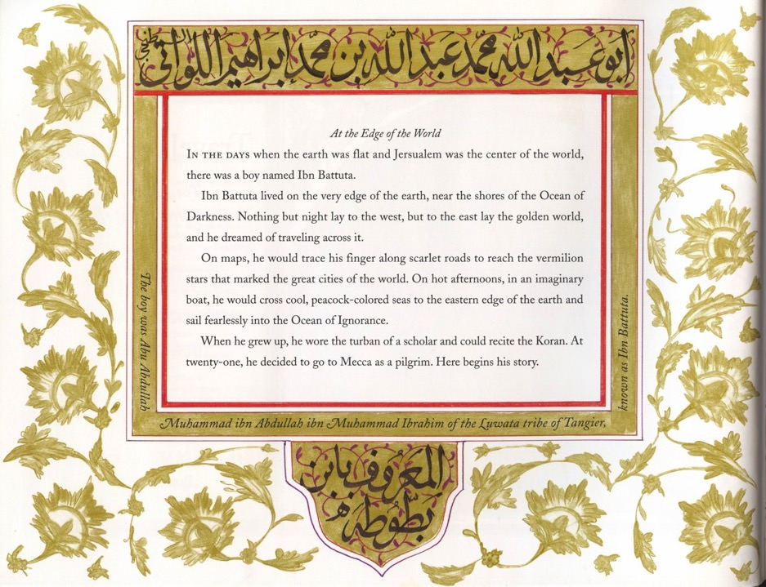

Slide 8
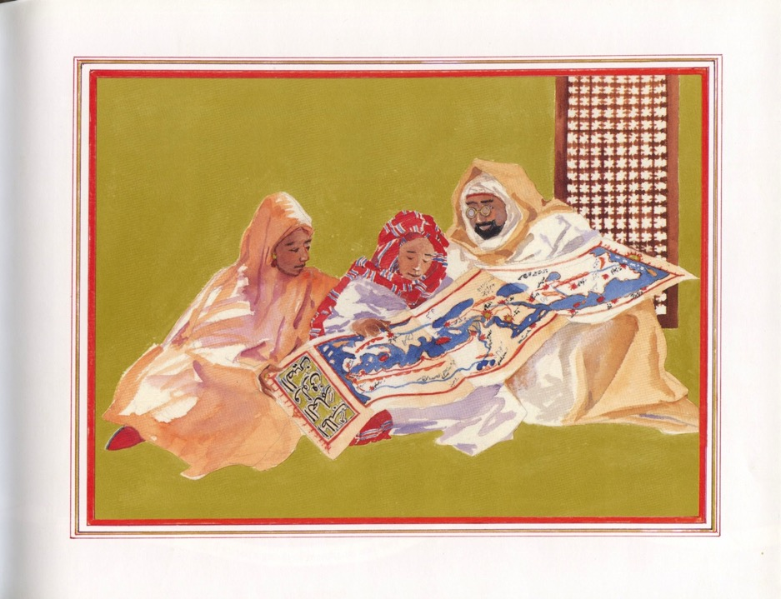

Slide 9
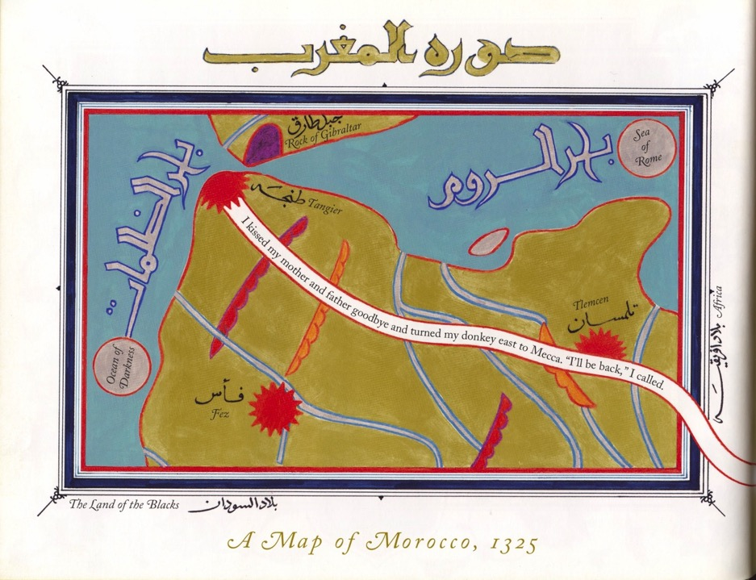

Slide 10
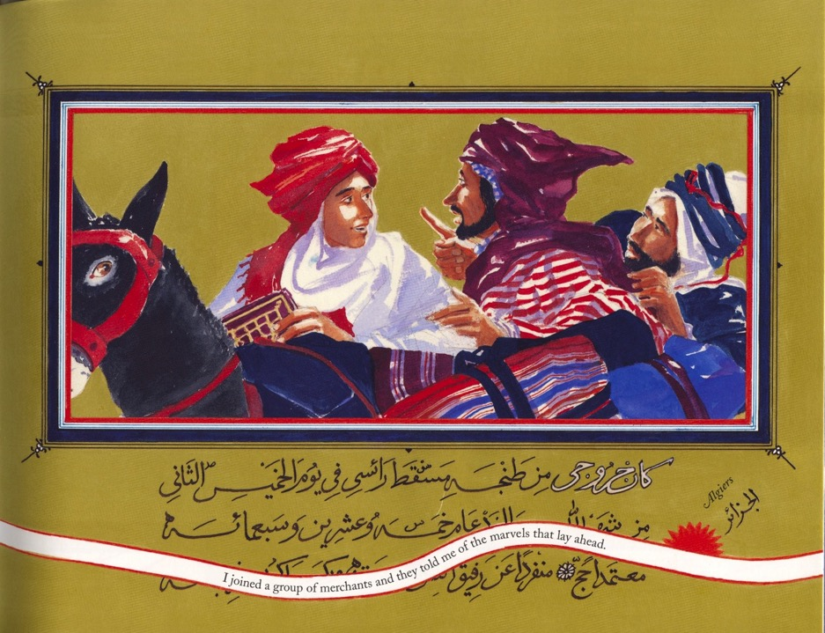

Slide 11
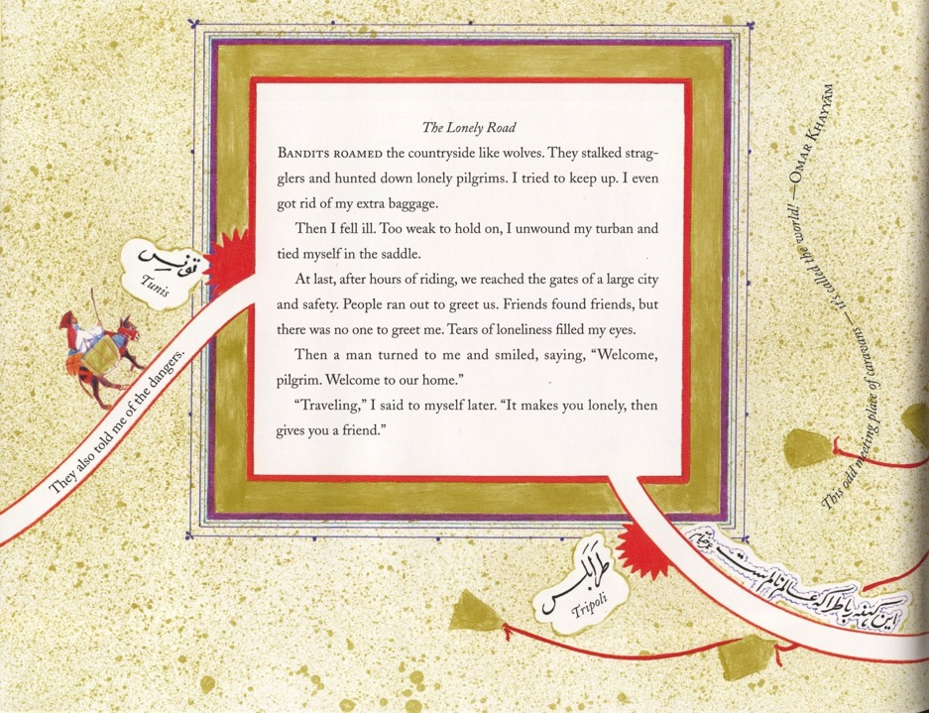

Slide 12
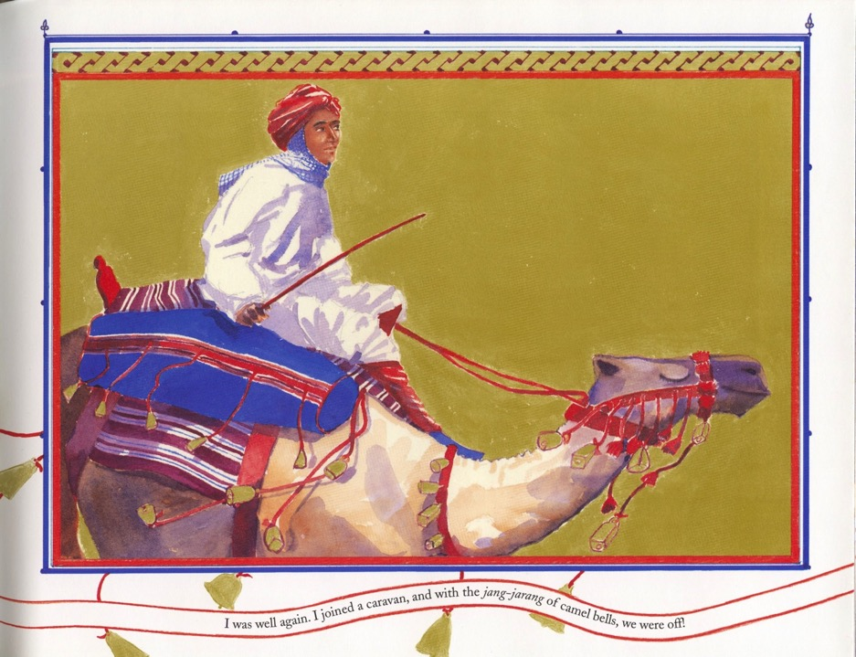

Slide 13
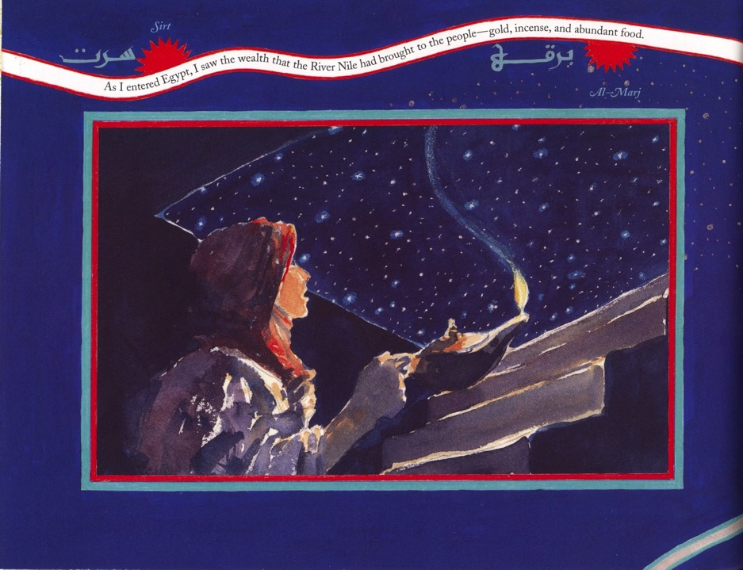

Slide 14
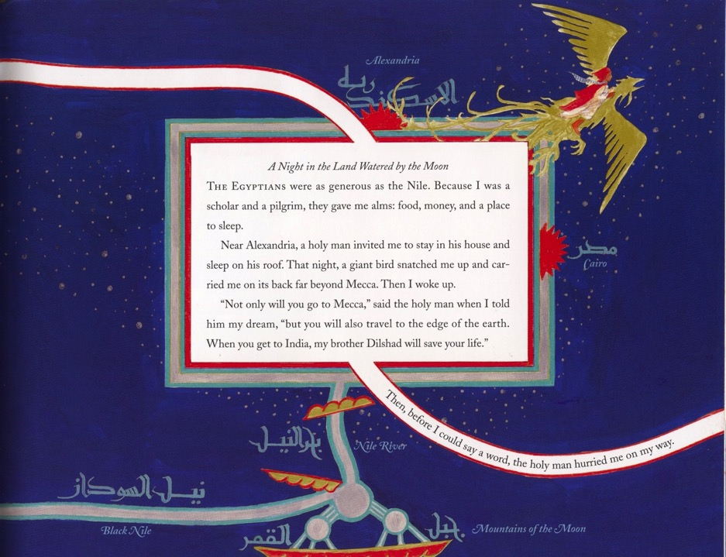

Slide 15
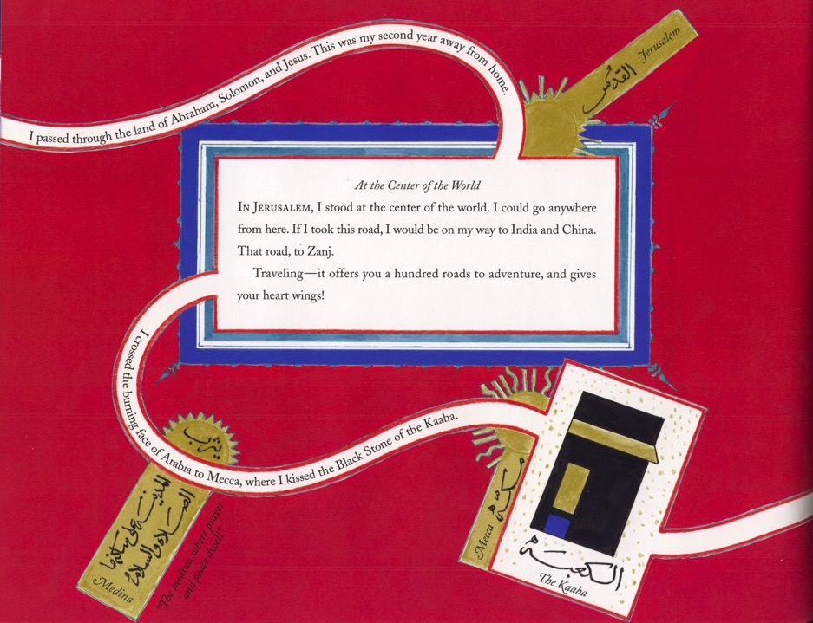

Slide 16
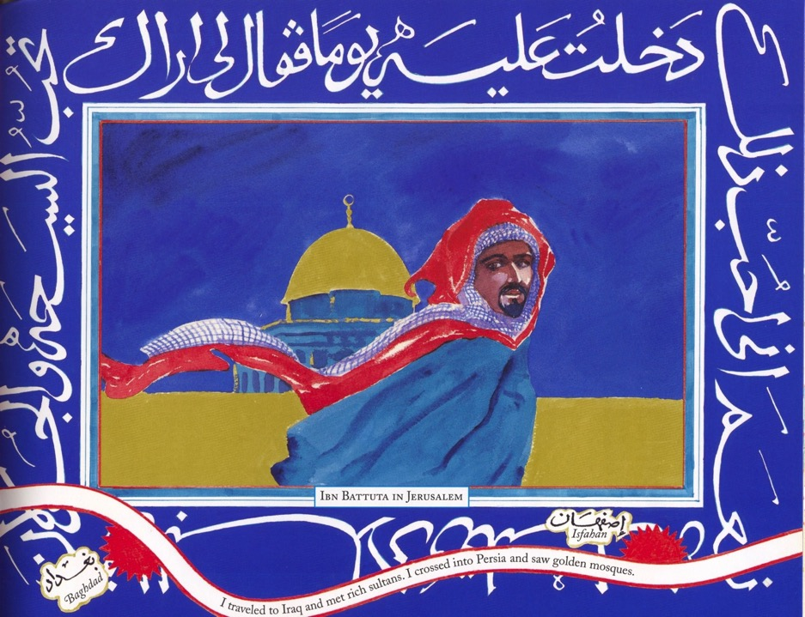

Slide 17
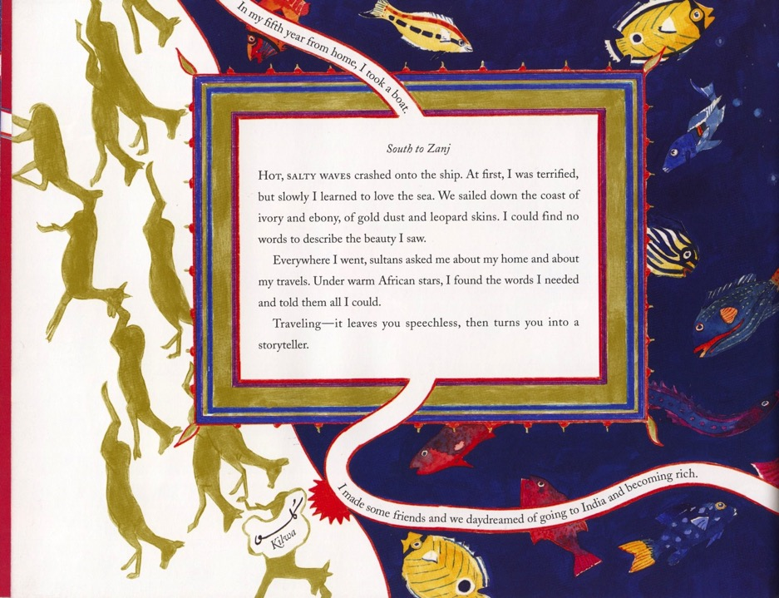

Slide 19
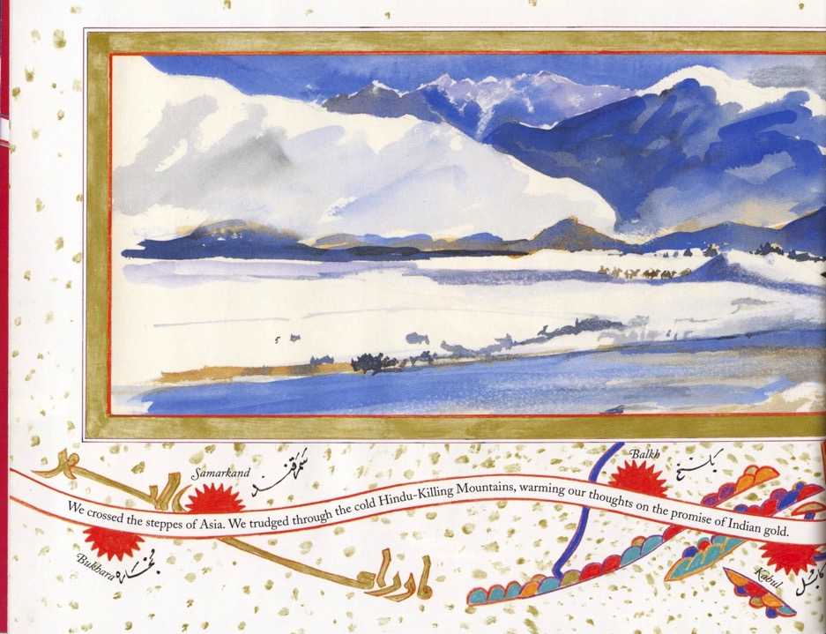

Slide 20
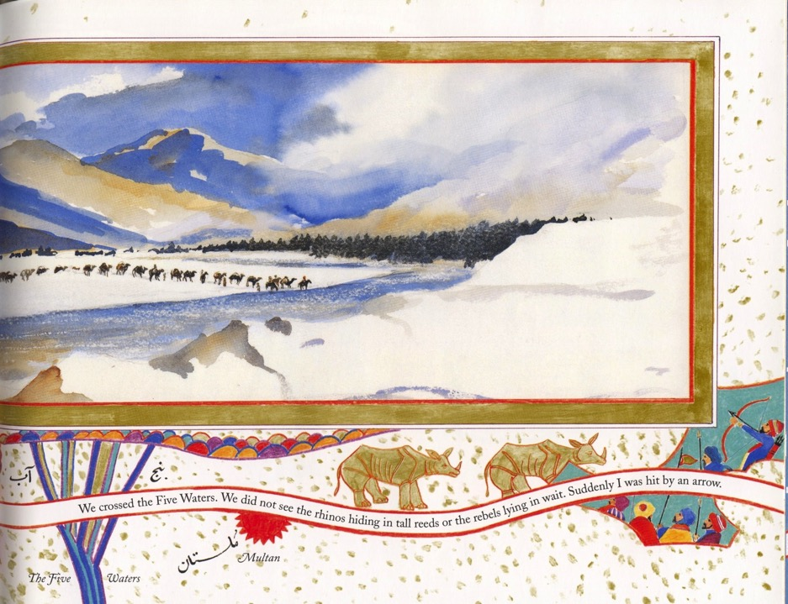

Slide 21
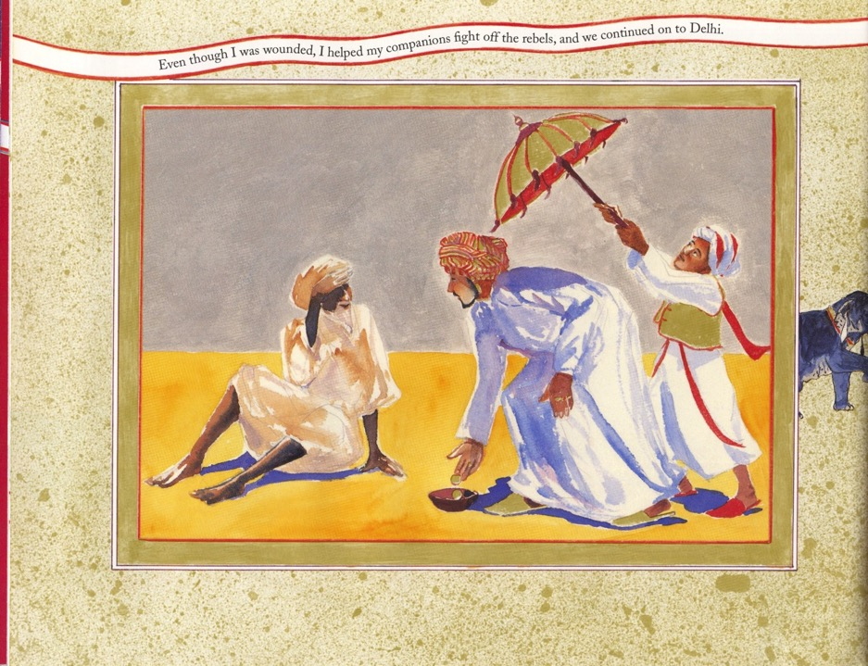

Slide 23
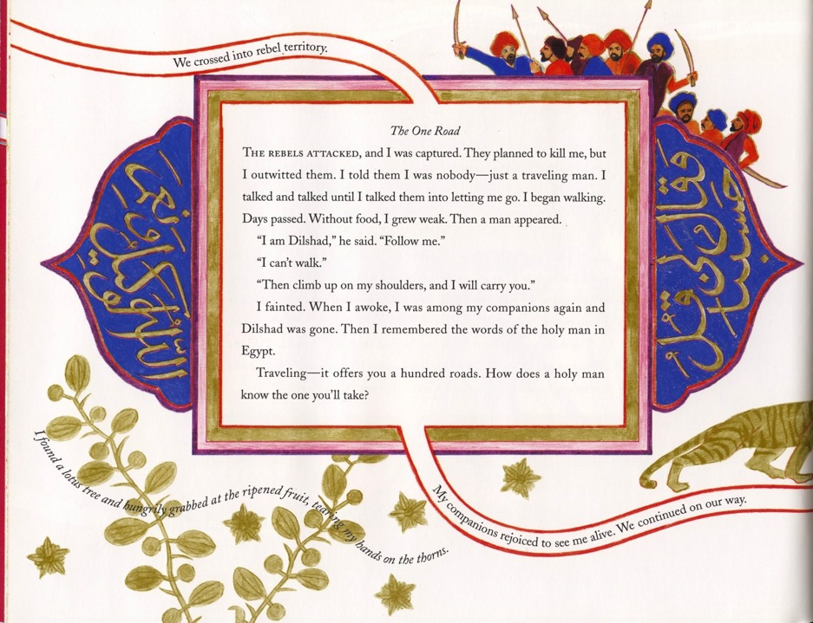

Slide 24
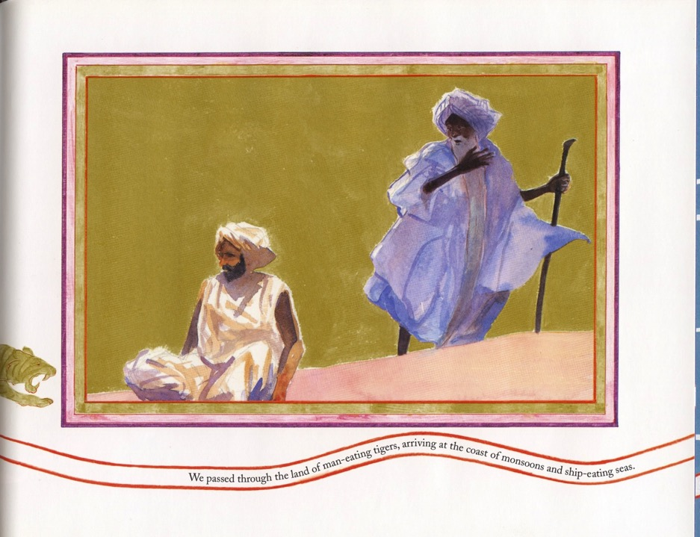

Slide 25
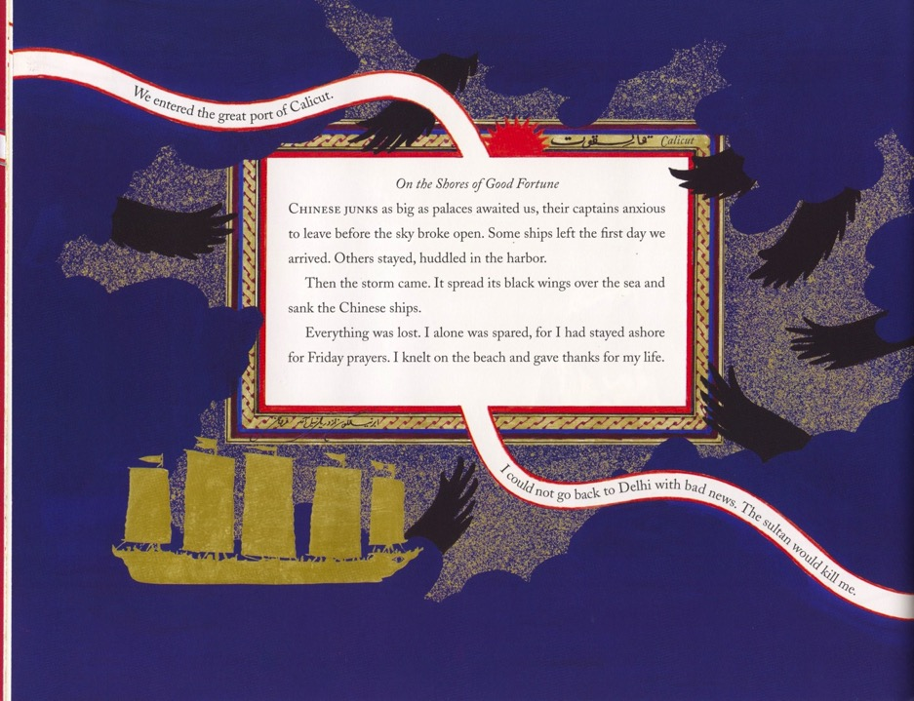

Slide 26
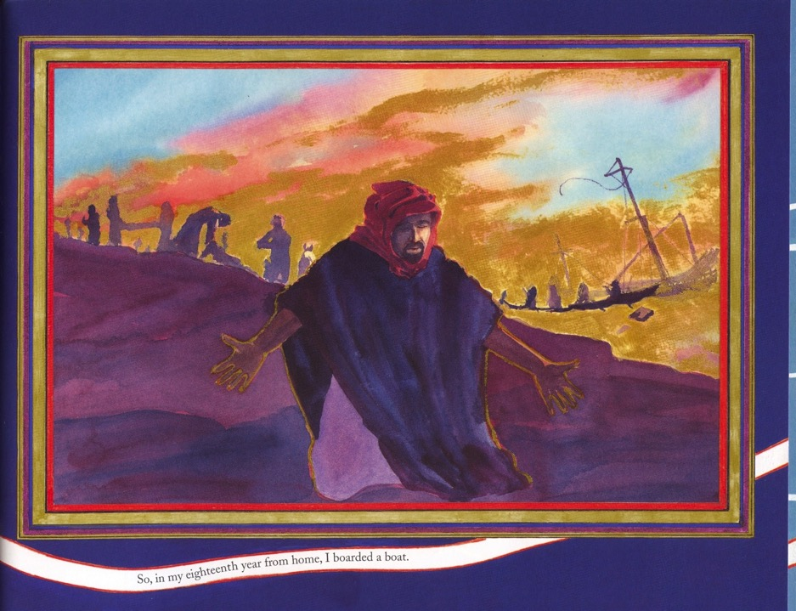

Slide 28
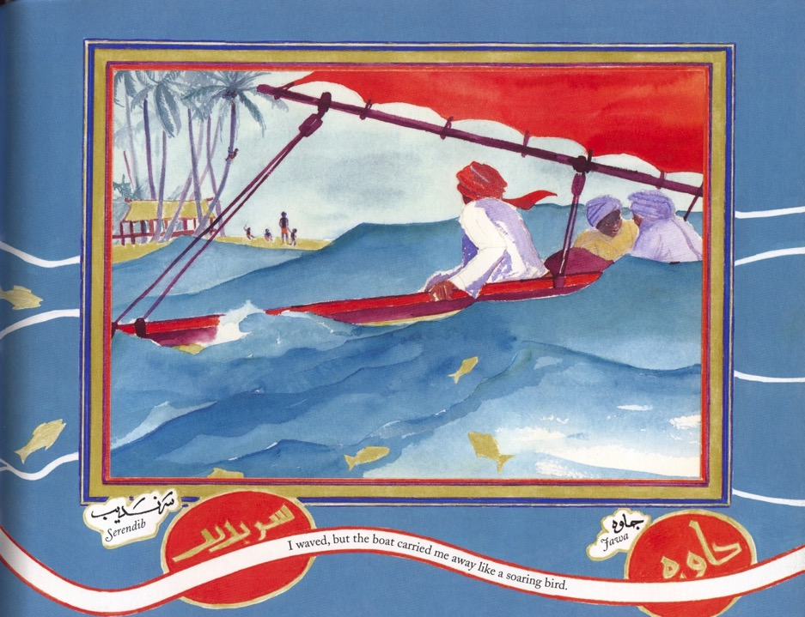

Slide 30
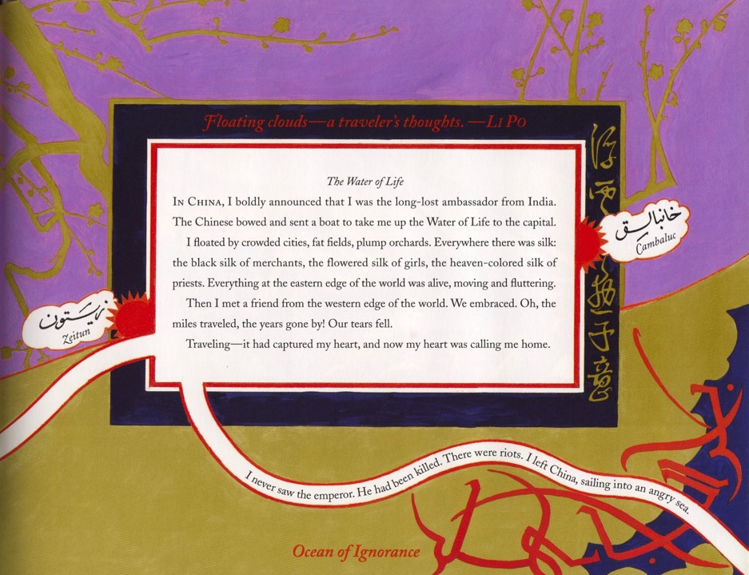

Slide 32
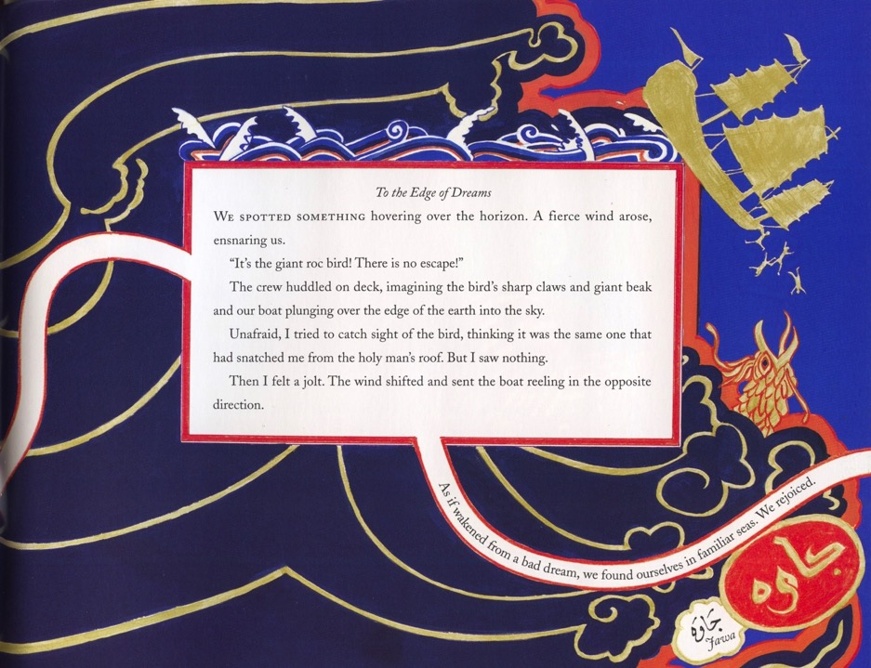

Slide 33
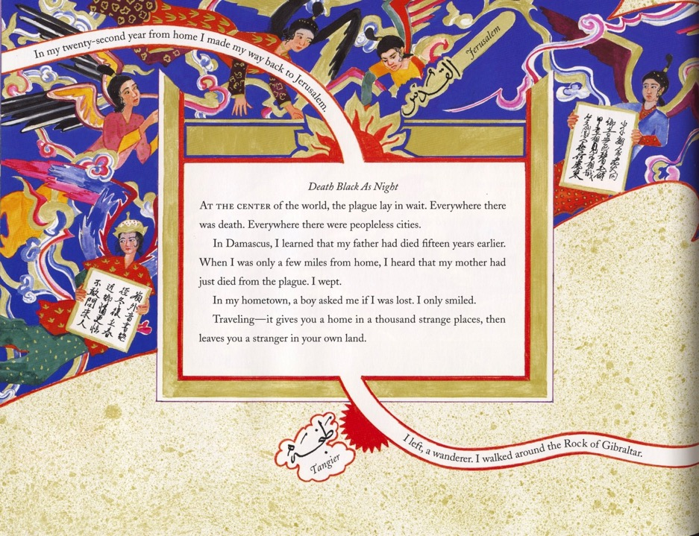

Slide 34
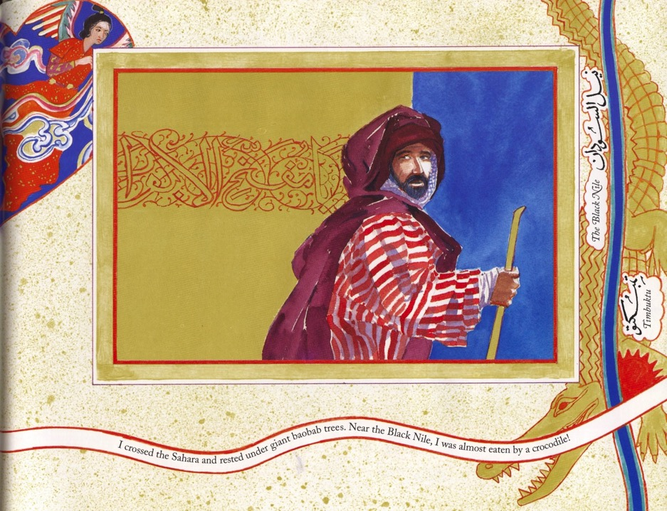

Slide 35
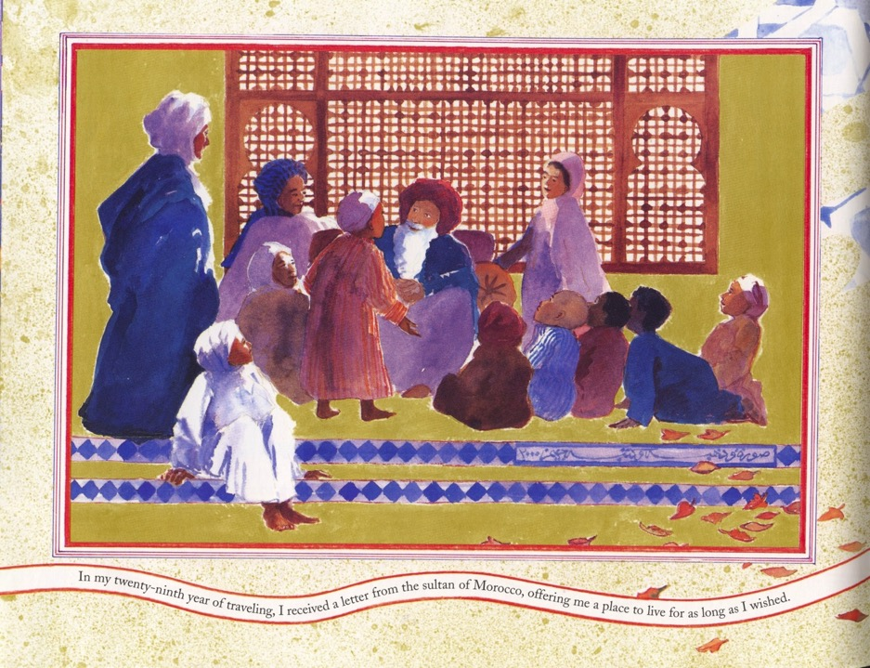

Slide 36
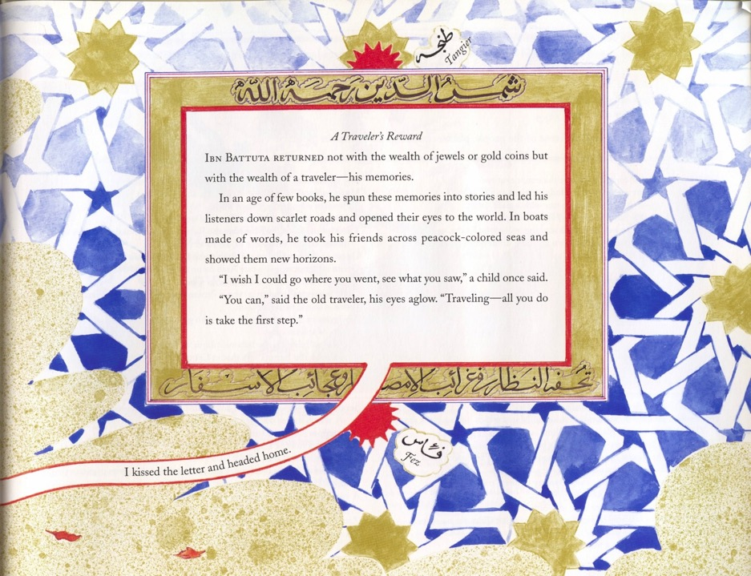

Slide 37
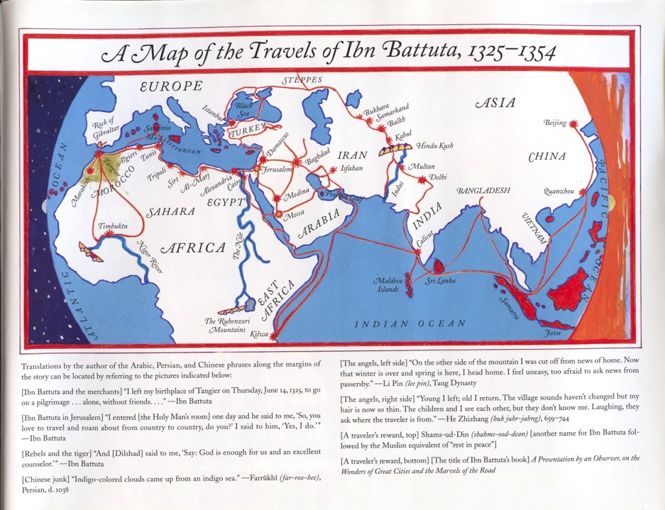

Slide 38
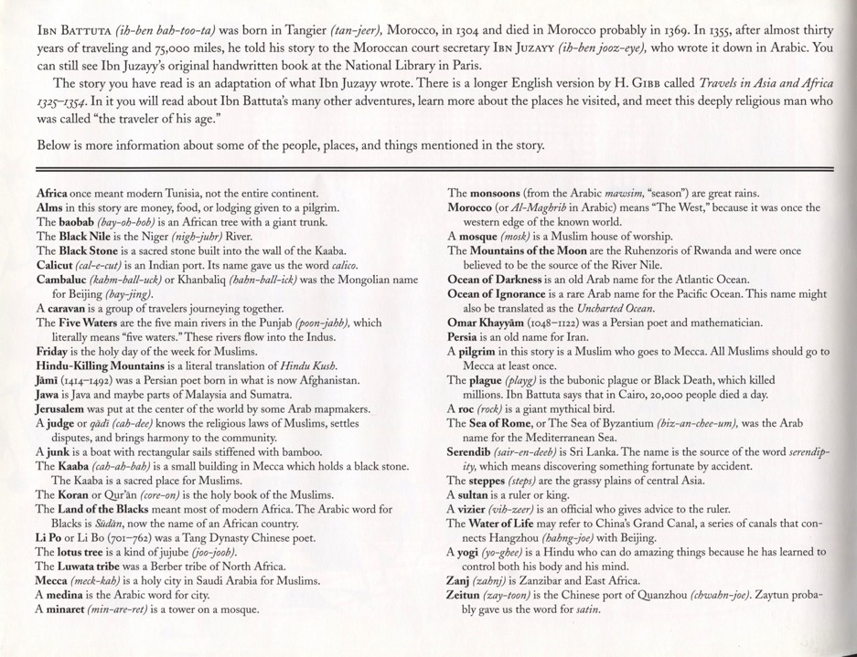

Slide 39
Ibn Battuta and the Tile art of the Middle East
Ibn Battuta was able to travel thousands of miles, partly because of the network of Mosques all over the Middle east and Asia.
We are going to look at the amazing mosaic tile art that can be found decorating those buildings then and now.

Slide 40
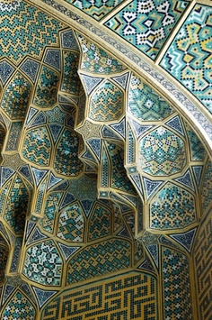
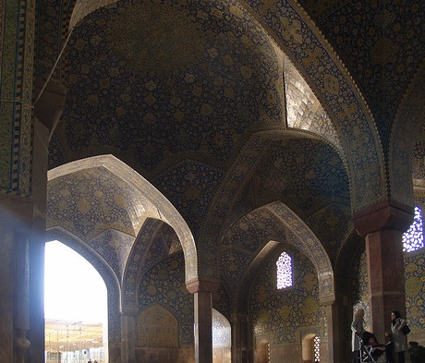
Architectural Geometry
Often, the architectural details of the building are covered with mosaics, both on the exterior and interior.

Slide 41
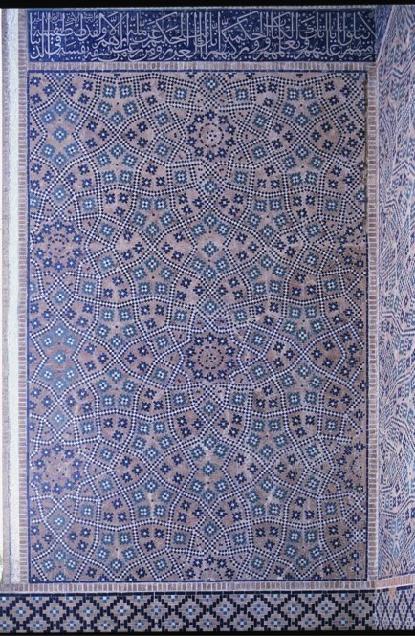
Tiles of Infinity
Some tile patterns are so complex that the mathematical principles underlying them have only been identified in the last 40 years.

Slide 42
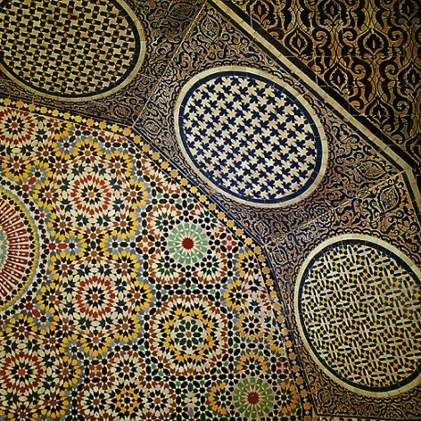
Non-periodic patterns
Patterns are non-periodic, which means they don’t repeat in predictable, symmetrical patterns.
This makes it significantly more complicated.

Slide 43
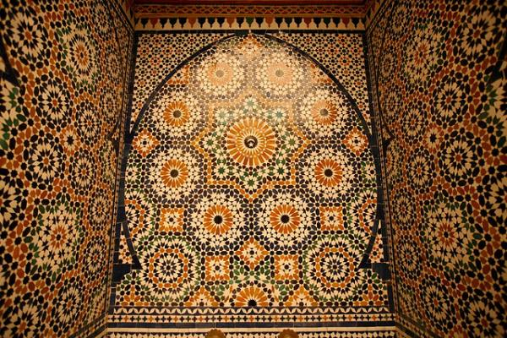
They use colors to highlight the larger shapes created from the individual tiles.

Slide 44
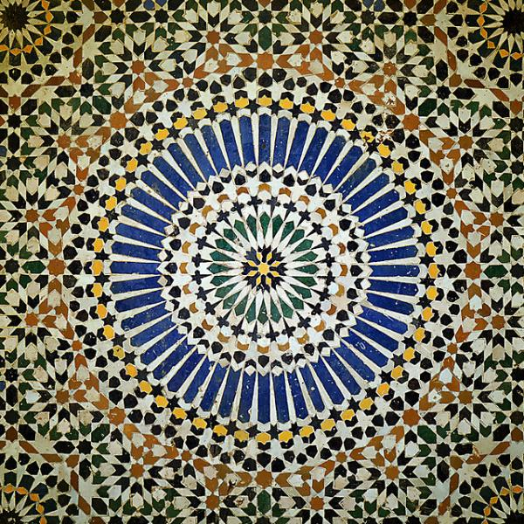
Individual Tile Shapes
What shapes do you see?
Do you see simple shapes combined to make a more complex shape?
How is color used?

Slide 45
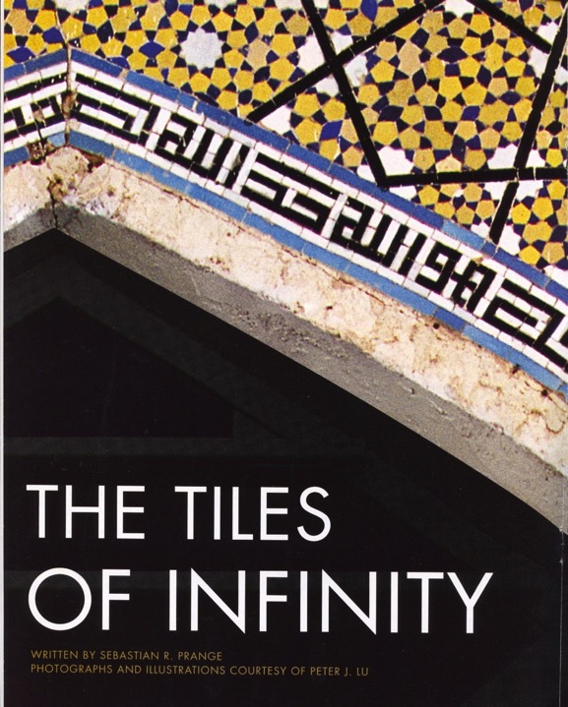
This article is meant as background information on the amazing non-repeating geometry of the tile mosaics of Islamic buildings.
The magazine’s goal is to broaden knowledge of the cultures, history and geography of the Arab and Muslim worlds and their connections with the West.
In this particular lesson, the emphasis is on the art of the tile designs and is not intended to promote in any way the religious aspects of the art form.

Slide 46
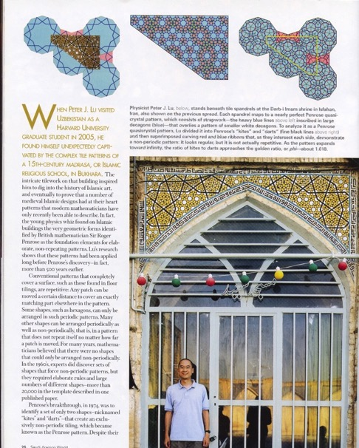
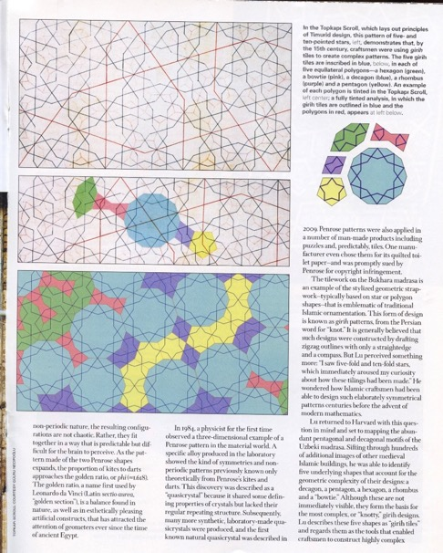

Slide 47
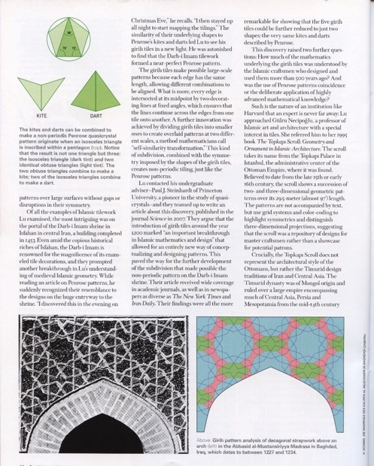
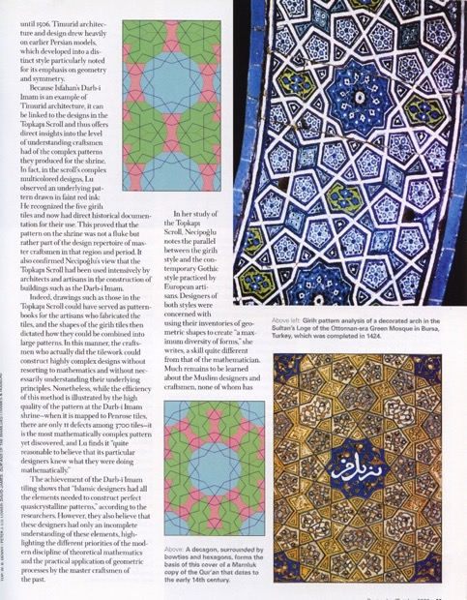

Slide 48
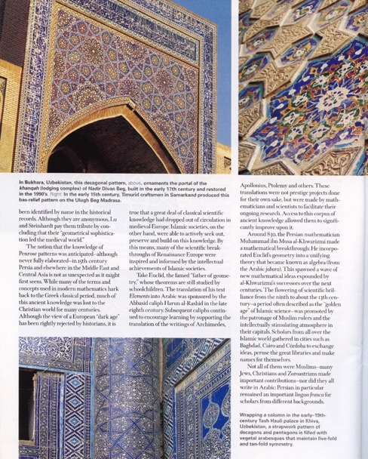
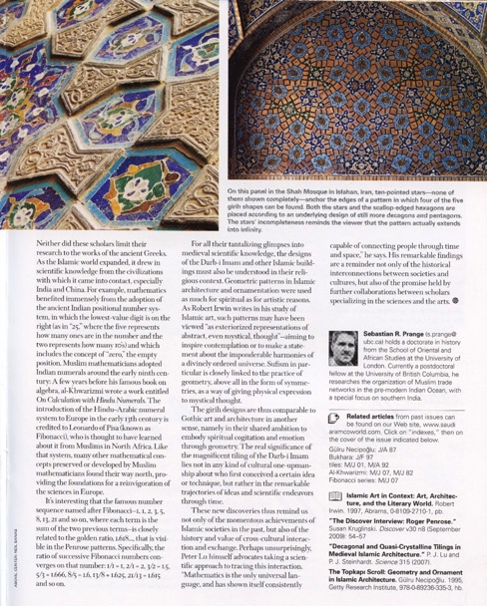

Slide 49
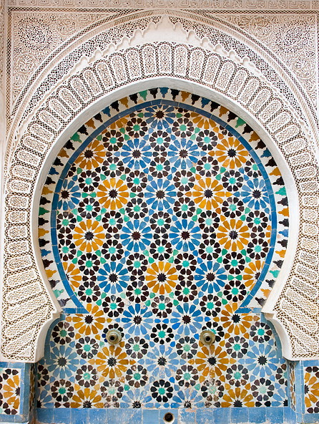
Today’s Project
Create a paper mosaic using squares, rhombi, and equilateral triangles
Use mosaic tile patterns for geometric and color inspiration

Slide 50
Step 1 – Fold Paper
Fold paper from corner to corner and side to side so that it is divided into 8 equal sections.
Fold the creases back so that the paper is as flat as possible.
Write your name on the back.

Slide 51
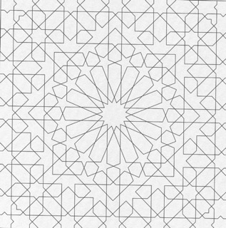
Step 2 – Choose a design
Look at the pattern pages.
What simple shapes do you see?
What complex shapes do you see?

Slide 52
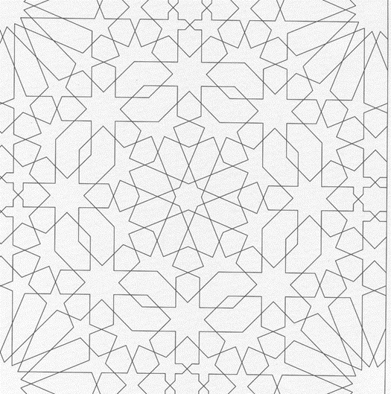
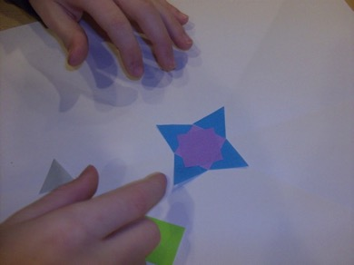
Step 3 – Center shape
Paper shape options
Square
Rhombus
Equilateral triangle
Experiment with making compound shapes from the simple shapes for your center.

Slide 53
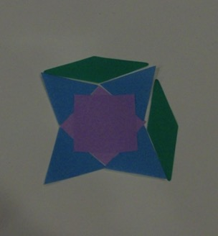
Step 4 – Concentric shapes
Refer to the pattern pages for ideas.
Use the fold lines of your paper for. symmetry guidelines
What shapes fit around your center shape?
Use colors to emphasize the pattern.

Slide 54
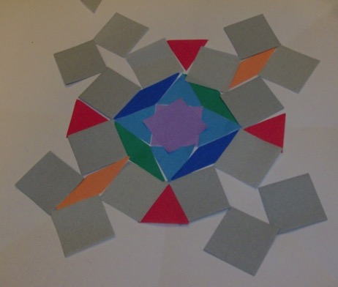
Step 5 – Plan out 2 rows
Decide on a pattern.
Plan out 2 concentric rows including the colors.
Then use glue stick to keep paper in place.
Use the extra white paper strip as a backing when gluing.

Slide 55
Step 6 – Plan 2 more rows
Plan 2 more rows.
Use color to emphasize your shape patterns.
Then glue.
Cover the paper all the way to the edge.
Trim any shapes that hang over the edge.

Slide 56
Display
Once the project is finished, student work should be mounted on black paper and displayed either in the classroom or in the designated area in the hallway.
If there are some who have not finished, please check with the teacher on how they would like to proceed. Do not assume that it ok to continue the project after the allotted time.

Slide 57
